Slide 1
Brainstorm What Makes Melbourne Liveable for Young People?
Infrastructure
Cultural
Economical
Environmental
Social
1375 schools
https://www.youtube.com/watch?v=tcrXW1WMvNs
https://www.youtube.com/watch?v=O7oBboFaeMo
https://www.youtube.com/watch?v=MMPSUPH4lvE
https://www.youtube.com/watch?v=PWX8ODzrGA0

Slide 2
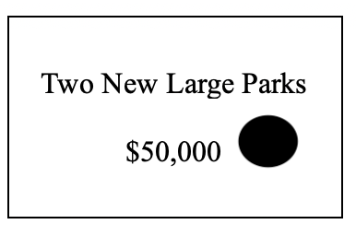
Individual Task
The Town of Narrogin needs your help to improve the liveability of the town for young people!
They have given you a budget of $400 million
Using the sheet provided choose where you would allocate this budget by marking it on the sheet.
Only allowed a maximum of 5 projects
In your books write 2-3 sentences justifying your spending

Slide 3
Group Task
The Shire of Narrogin loves your individual ideas to enhance liveability! To ensure consistency in budgeting for young people they would like you to work in teams.
As a team you need to work collaboratively to allocate funding for important projects (no more than 5 projects)
Each group member has a budget of $100 million and can spend no more then $50 million of their own budget per strategy.
Members can combine their money; for example, each member could put in $10 million to build a Bunnings.
You will need to to write a letter to the Shire of Narrogin representative to justify your group’s choice

